Slide 1
INTERNET,SURFING AND E-MAIL
AND
NETWORKING

Slide 2
NETWORKING
A network is a connection of several computers together for a purpose of sharing information.
Networking is an act of connecting/Linking the computers together.

Slide 3
Types of network
    There are 3 types of network namely:-
Local area network (LAN)
Metropolitant Area Network (MAN)
Wide area network (WAN)

Slide 4
LOCAL AREA NETWORK
This is the network which covers an organization.
A learning institution
A financial institution
A government institution

Slide 5
Metropolitant area network (MAN)
Is a network which covers a specific geographical location e.g. city or town

Slide 6
WIDE AREA NETWORK (WAN)
Is a network which covers a large geographical area such as countries, cities in a distant places and continents.

Slide 7
Difference between LAN and WAN
LAN
WAN
Covers small geographical area
Involves less machines
Data transmission is faster
Is cheap
Is easy to install and configure
Data transmission is digital (covers short distance)
Connectivity can be done by use of cables.
Covers a large geographical area
Involves more machines
Data transmission is slow
Is expensive
Complex to install and configure
Data transmission is analogue (covers long distance)
Connectivity can be done by wireless connection.

Slide 8
Importance of networking
Helps/provides sharing of information
Provides sharing of more computer resources, software, program data & ideas.
Enhances communication
Facilitates access to the remote computer
Provides data sharing

Slide 9
Demerits of networking
Very expensive to setup
There is provision of information confidentially which can result to a security threat.
there is no control of information flow; virus can flow fast.
Un authorised individual can get access to the information.

Slide 10
Network connecting requirements
Hardware
Software (Network operating system)
Cables
Personal in charge of administration i.e Network administrator
Connecting devices i.e. Network interface card (NIC)

Slide 11
Internal LAN connections
Can be:-
Coaxial cables
Twisted copper wire.
Fibre optic cable
Wire less connection can be:-
Bluetooth
Infrared
Radio-frequency transmission.
Network use protocols to exchange information through a single shared connection to prevent collision of data caused by simultanous transmission between two or more computers.

Slide 12
Examples of protocols
Ethernet
Token ring
Ethernet linked computer checks if shared connection is in use. If not the computer transmits data.
Token ring protocols pass a special message called a token through the network

Slide 13
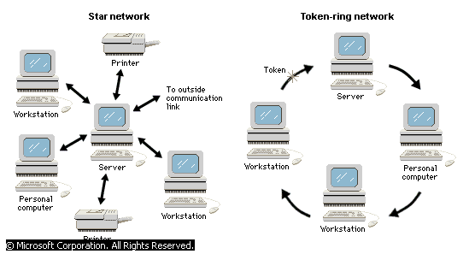
A token ring protocol

Slide 14
External LAN connectors
they include:-
Bridges
Routers
Gateways
Bridge creates en extended Lan by passing information between two or more LANs.
A router is an intermediary device that connects a LAN to a larger LAN or WAN.

Slide 15
STAR NETWORK
A star network connects many computers and computer resources, such as a printer, to a central computer called a server that directs the flow of information. A token-ring network uses a special message called a token that travels from computer to computer. The token designates which computer sends information through the network.

Slide 16
STAR TOPOLOGY

Slide 17
Bus Network
In a bus network configuration, each node is connected to one main communications line. With this arrangement, even if one of the nodes goes down, the rest of the network can continue to function normally.

Slide 18
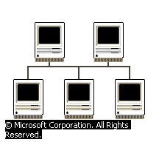
BUS TOPOLOGY

Slide 19
Ring Network
In a ring network, messages travel in one direction around a ring from node to node. As each node receives a message, it checks the message address. If the message is not for that particular node, the message is regenerated and passed on. This regeneration allows messages to travel farther in a ring network than in other network configurations.
© Microsoft Corporation. All Rights Reserved.

Slide 20
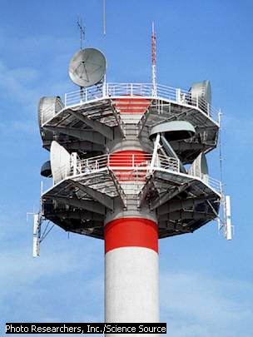
Wireless connection
High-frequency microwave transmissions are beamed from point to point using tall antennas. The antennas must be within sight of each other, since the microwave signals travel in straight, narrow paths.

Slide 21
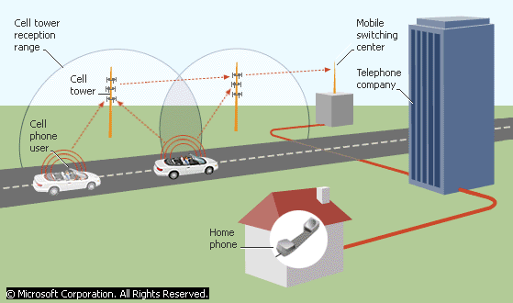
How wireless communication works

Slide 22
How Wireless Communications Work
Cellular radio telephones, also known as cell phones, communicate by sending radio signals to a cell tower. Each cell tower has a certain range within which it can receive the radio signals. The range of each tower overlaps with that of another tower so as a mobile cell phone user travels, communication is uninterrupted. To communicate with the user of a wired telephone, the cell phone radio signals are routed from the cell tower to a mobile switching center, which in turn routes the signals to the telephone company. The signals then travel over telephone lines to reach a wired telephone.

Slide 23
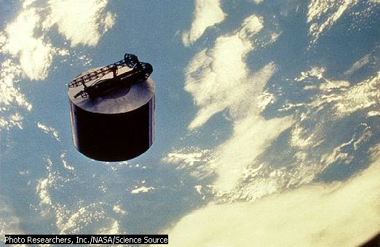
satellite

Slide 24
Communications Satellite
The Syncom 4 communications satellite was launched from the space shuttle Discovery. Modern communications satellites receive, amplify, and retransmit information back to earth, providing television, telefax, telephone, radio, and digital data links around the world. Syncom 4 follows a geosynchronous orbit—that is, it orbits at the same speed as the earth spins, keeping the satellite in a fixed position above earth. This type of orbit enables uninterrupted communication links between ground stations.

Slide 25
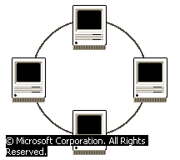
RING TOPOLOGY

Slide 26
INTERNET

Slide 27
internet
Is worldwide computer network linking countless thousands of computer network through a mixture of print and public data and telephone lines.
OR
A large network of networks that covers the whole world and enables millions of computer from different organization and people to communicate globally because of its large size and great volume if is called the information superhighway

Slide 28
Development of internet
In 1969 the defence advanced research project agency (DARPA) of the United States Department of Defence (DOD) built the first network known as (ARPAN) advanced research projects agency network.
The military internet was to built a network that could continue to work in the event of war even if parts of the network was to allow data and information between computer.
ARP nets goal was to allow multiple of user to send of reserve information.
The first 4 soles that were linked to form ARPANET were university of California in Los Angels, University of California in Saint Barbra, University of Ufah and Stanford Research Institute.
By 1994 3 million computer were linked to the internet and today internet has grown and covered the whole world.

Slide 29
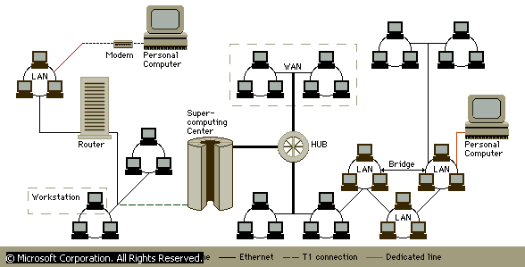
Internet topology

Slide 30
Internet Topology
The Internet and the Web are each a series of interconnected computer networks. Personal computers or workstations are connected to a Local Area Network (LAN) either by a dial-up connection through a modem and standard phone line, or by being directly wired into the LAN. Other modes of data transmission that allow for connection to a network include T-1 connections and dedicated lines. Bridges and hubs link multiple networks to each other. Routers transmit data through networks and determine the best path of transmission.

Slide 31
INTERNET CONNECTIVITY REQUIREMENTS
Personal computer (PC)
Telecommunication facilities (Phone line)
Internet software and communication software
Modems
Internet service providers (I.S.Ps)

Slide 32
Personal computer (PC)
The PC should be a 486 or higher running window and well enough memory (8 MB of RAM & 200 MB hard disk minimum) to run the current web browser.

Slide 33
Telecommunication facility
The internet relies on telecommunication facilities like the telephone lines, telephone exchange stations and satellite transmission in order to cover whole world.

Slide 34
Modem
Modem, device that enables computers, facsimile machines, and other equipment to communicate with each other across telephone lines or over cable television network cables. In the strictest sense, a modem is a device that converts between analog signals, such as sound waves, and digital signals, which are used by computers. However, the term has also come to include devices that permit the transmission of entirely digital signals.
Modems transmit data at different speeds, measured by the number of bits of data they send per second (bps). A 28.8 Kbps modem sends data at 28,800 bits per second. A 56 Kbps modem is twice as fast, sending and receiving data at a rate of 56,000 bits per second.

Slide 35
II ANALOG MODEMS
An analog modem converts the digital signals of the sending computer to analog signals that can be transmitted through telephone lines. When the signal reaches its destination, another modem reconstructs the original digital signal, which is processed by the receiving computer. A standard analog modem has a maximum speed of 33.6 Kbps.
The word modem is an acronym formed from the two basic functions of an analog modem: modulation and demodulation. To convert a digital signal to an analog one, the modem generates a carrier wave and modulates, or adjusts, it according to the digital signal. The kind of modulation used depends on the application and the speed of operation for which the modem is designed. For example, many high-speed modems use a combination of amplitude modulation, in which the amplitude of the carrier wave is changed to encode the digital information, and phase modulation, in which the phase of the carrier wave is changed to encode the digital information. The process of receiving the analog signal and converting it back to a digital signal is called demodulation.

Slide 36
IIII NTEGRATED SERVICES DIGITAL NETWORK
Instead of converting between analog telephone lines and digital applications, Integrated Services Digital Network (ISDN) carries digital signals throughout the transmission process. Because an ISDN modem does not convert between digital and analog signals, it does not perform the modulation and demodulation functions from which modems derived their name. An ISDN modem simply processes the digital signal between the computer and the ISDN lines.
ISDN transmission lines are ordinary two-wire telephone lines that carry digital signals on three separate channels. The telephone company uses one channel for tracking and control purposes; the remaining two channels can be used to transmit voice, data, or both. Digital data bypasses the analog voice network, enabling it to travel much faster. ISDN has a maximum speed of 128 Kbps.

Slide 37
IV ASYMMETRICAL DIGITAL SUBSCRIBER LINE
Like ISDN, Asymmetrical Digital Subscriber Line (ADSL) permits the transmission of digital data over ordinary telephone lines. It is called asymmetrical because it transmits data in one direction (from the network) faster than it does in the other direction (to the network). ADSL carries signals to the network at speeds of up to 640 Kbps, and it can deliver data from the network at speeds of up to 8.1 million bits per second (Mbps).
An ADSL modem splits an ordinary telephone line into three separate data channels, each with different capacities and speeds. The lowest-capacity channel transmits analog voice data; a second, medium-capacity channel transmits data to the network; and the highest-capacity channel transmits data from the network.
A number of other forms of DSL are also available, depending on the speed of data transmission and the distance of the customer from the central office. These include High-Data-Rate Digital Subscriber Line (HDSL), Very-High-Data Rate Digital Subscriber Line (VDSL), and Symmetric Digital Subscriber Line (SDSL).

Slide 38
V CABLE MODEM
Cable modems permit the transmission of data over community antenna television (CATV) networks—that is, the network of cables used to distribute cable television. A cable modem transmits data from the network at about 3 Mbps and transmits data to the network at between 500 Kbps and 2.5 Mbps.
Like a standard analog modem, a cable modem converts between a digital signal and an analog signal. Cable modems are much more complex than standard analog modems. They also incorporate a tuner that separates the digital data from the rest of the broadcast television signal. Because users in multiple locations share the same cable, the modem also includes hardware that permits multiple connections and an encryption/decryption device that prevents data from being intercepted by another user or being sent to the wrong place.

Slide 39
Frequency Modulation
Frequency Modulation (FM), system of radio transmission in which the carrier wave is modulated so that its frequency varies with the audio signal being transmitted. The first workable system for radio communication was described by the American inventor Edwin H. Armstrong in 1936. See Radio.
Frequency modulation has several advantages over the system of amplitude modulation (AM) used in the alternate form of radio broadcasting. The most important of these advantages is that an FM system has greater freedom from interference and static. Various electrical disturbances, such as those caused by thunderstorms and automobile ignition systems, create amplitude modulated radio signals that are received as noise by AM receivers. A well-designed FM receiver is not sensitive to such disturbances when it is tuned to an FM signal of sufficient strength. Also, the signal-to-noise ratio in an FM system is much higher than that of an AM system. Finally, FM broadcasting stations can be operated in the very-high-frequency bands at which AM interference is frequently severe; commercial FM radio stations are assigned frequencies between 88 and 108 Mhz. The range of transmission on these bands is limited so that stations operating on the same frequency can be located within a few hundred miles of one another without mutual interference.

Slide 52
These features, coupled with the comparatively low cost of equipment for an FM broadcasting station, resulted in rapid growth in the years following World War II (1939-1945). Within three years after the close of the war, 600 licensed FM stations were broadcasting in the United States. In 2000, there were about 5,770 FM stations. Because of crowding in the AM broadcast band and the inability of standard AM receivers to eliminate noise, the tonal fidelity of standard stations is purposely limited. FM does not have these drawbacks and therefore can be used to transmit musical programs that reproduce the original performance with a degree of fidelity that cannot be reached on AM bands. In 1961 the Federal Communications Commission authorized FM stereophonic broadcasting. Thereafter, the FM band drew increasing numbers of listeners to popular as well as classical music, and commercial FM stations began to draw higher audience ratings than AM stations.

Slide 55
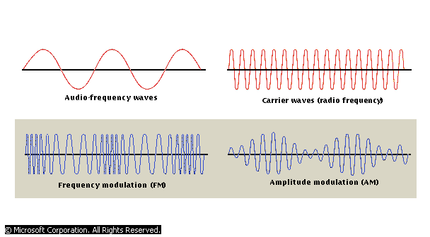

Slide 56
Internet service providers
This are companies that offers internet services to the end users. For example in Kenya jambonet, Africaonline and swift kenya

Slide 57
Internet software and communication software
The internet connects million of computers and telecommunication devices that have different configuration for hardware and software that are incompatible to achieve communication between these devices a special software is needed.
The most common is transmission control protocol (TCP) and internet protocol (IP).
TCP controls or governs how data is transferred form one place to the next.
IP determines the addressing system on the internet e.g. every computer on the internet is recognised by a special number called the IP address that enables data to be sent and received by it.
You also need a web browser software that you will use to browse the internet

Slide 58
SERVICES OFFERED BY THE INTERNET

Slide 59
1. THE WORLD WIDE WEB (WWW)
Is a vast virtual space on the internet where information pages called websites are installed.
To enable easier access to the internet a standard method of preparing a document t be put on the internet was developed.
Those methods use a special language such as hyper text mark up language (HTML) to prepare document called web page that are attractive and can be accessed on the internet
Industrial and organisation establish sides where these web document can be placed for easy access by the external world called web sites
Each site has a special address called Uniform Resource Location (URL) that can be used to access them e.g. a common URL address is :-http://www.yahoo.com
http stands for hypertext transfer protocol
www. It’s the name for the internet server on which the web page is located.
yahoo. com It’s the domain name of local area network. It uniquely identifies a particular local area network.

Slide 60
2. COMMUNICATION SERVICES
The communication service offered by the internet include:-

Slide 61
a. E-Mail
Is a quick convenient, efficient and cheap way to communicate with both individual and groups. It’s the most popular internet service.

Slide 62
b. Fax services
Internet subscribers send faxes from their computer to far machines or to multiple destinations. Faxing is sending where the original remains with the sender while the copy is transmitted over communication wires. It is like a long distance photocopying.

Slide 63
c. Chat
Allows a large number of people to talk amongst themselves in real time from various locations.
To chat you need to get connected and from a channel.

Slide 64
CONFERENCING
Is the dynamic exchange of all kinds of information text graphics H.T.M.L link to information on audio video etc
In a context a structured conversation. The goal of such structure of online conversation may be decision making technical support community building project management. Distance education meeting and more.

